Slide 1
Skeletal System – Joints
Mrs. Malinowski
Grade 6
2015

Slide 2
What are joints?
Joints are places where bones meet
The study of joints is called “arthrology”
One bone can have 2 or more joints

Slide 3
Functions of Joints
Allows for smooth movements
Allows you to grow
Minimize friction and cushion bones against impact
Support your body

Slide 4
Where do we find movable joints?
With your table, make a list of all the places you think we have joints!

Slide 5
Classifications of Joints
Joints are classified according to what material unites the bones
3 main types:
  Fibrous joints: joined by fibrous tissue
  Cartilaginous joints: united by cartilage
  Synovial joints: connected by synovial membrane which surrounds the joint cavity

Slide 6
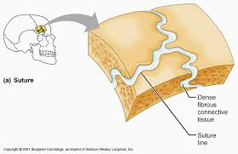
Fibrous Joints
Immovable
Held together by only a ligament
Examples:
  Teeth attached to sockets in jaw
  Bones in the skull joined together

Slide 7
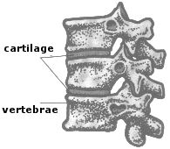
Cartilaginous Joints
Occur where cartilage connects bones
Examples:
  Between vertebrae in spine

Slide 8
Synovial Joints
6 types of Synovial Joints
  Plane/Gliding joint
  Hinge joint
  Condyloid/Ellipsoid joint
  Saddle joint
  Ball and socket joint
  Pivot joint

Slide 9
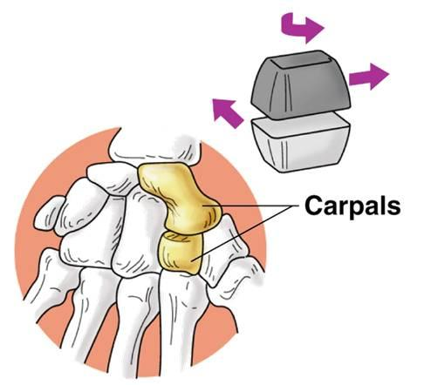
Synovial Joints: Plane/Gliding Joint
Allows gliding or sliding movement
Bones involved usually have flat surfaces
Examples:
  Shoulder (between scapula and clavicle)
  Joints between vertebrae
  Between bones in your hand

Slide 10
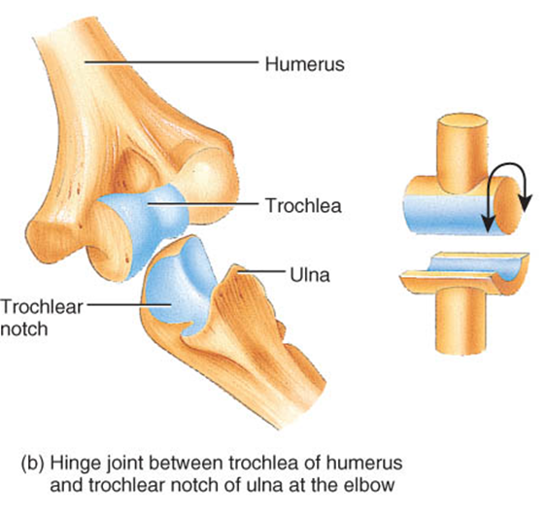
Synovial Joints: Hinge Joint
Can move in the axis at a right angle to the joints involved
Can “open and close like a door”
Movements include bending and straightening
Examples:
  Elbow joint where humerus and ulna meet
  Fingers
  Knees

Slide 11
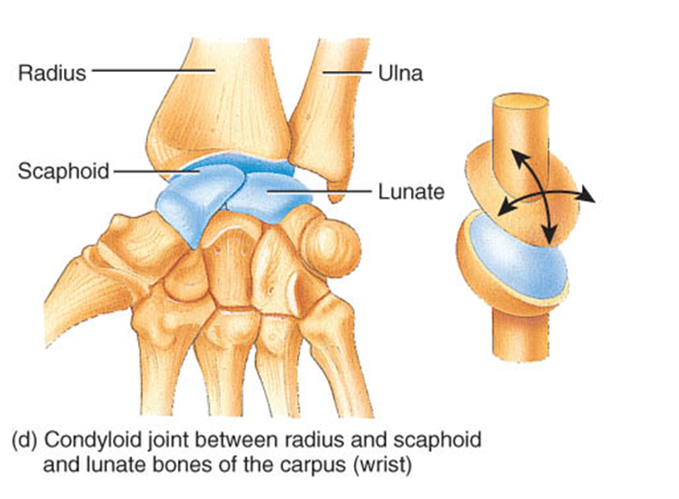
Synovial Joints: Condyloid/Ellipsoid Joint
Allows movement in two axes
Can bend it, straighten it, move it from side to side and rotate it
Examples:
  Wrist

Slide 12
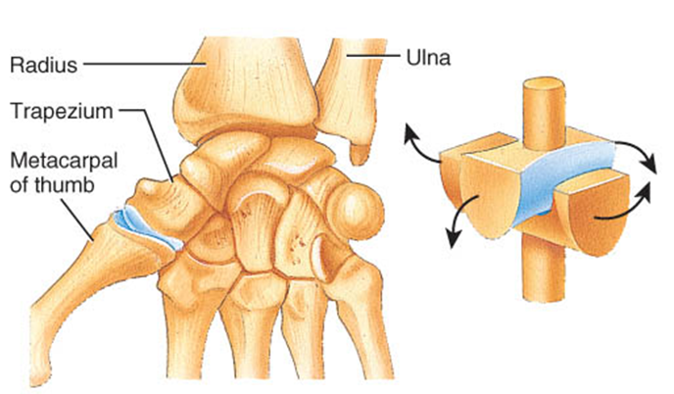
Synovial Joints: Saddle Joint
Opposing surfaces of involved bones look like a saddle
Allows for 2 different types of movements
Examples:
  Thumb

Slide 13
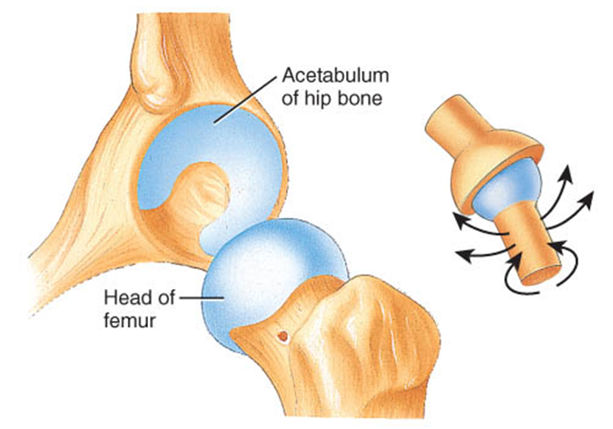
Synovial Joints: Ball and Socket Joint
Most versatile synovial joints
Can move on many axes
One joint has a ball, and the other a socket
Can bend, flex, open, close, rotate and circularly move at this joint
Examples:
  Shoulder joint
  Hip joint

Slide 14
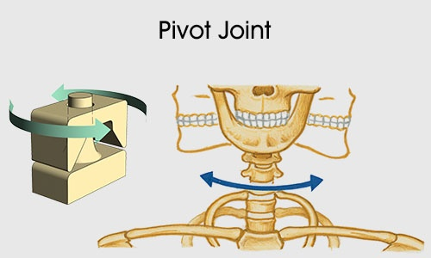
Synovial Joints: Pivot Joint
Also known as rotary joints
Only allow rotation
One bones serves like a ring, while the other bone has a rounded process rotating with the ring
Examples:
  neck

Slide 15
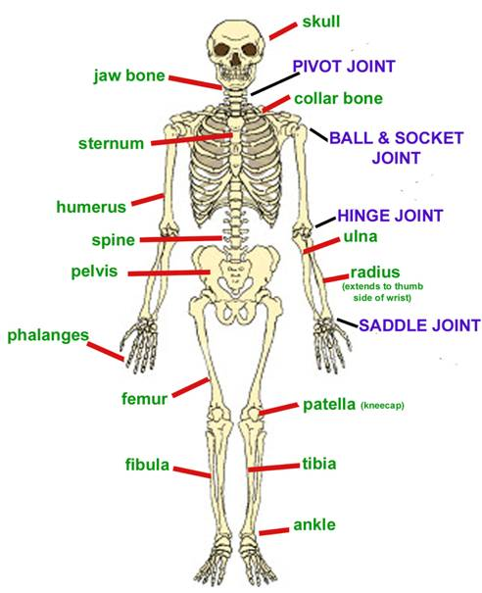
Joint Lab

